Slide 1
Fraud Detection using Supervised Learning Classification
Mentor Subramanian Palamarneri
Team Members
Ajay Krishnan, Babloo Kumar S, Panduranga A, Rabi Bastin J, Gopi Selvaraj

Slide 2
Problem Definition
The objective of this project is to develop a robust and accurate fraud detection model using supervised learning classification techniques. The model should be able to classify transactions or activities into two categories: "fraudulent" and "non-fraudulent," based on historical data and relevant features.
The dataset provided for this project contains historical transaction data, where each transaction is described by a set of features. These features includes such as transaction amount, transaction date and time, user information, and other relevant details. Additionally, each transaction is labeled as either "fraudulent" or "non-fraudulent.

Slide 3
About Dataset
S.No | Field name | Description | Data type
1 | Accountnumber | Unique identifier for the account associated with the transaction. | Float64
2 | Customerid | Unique identifier for the customer associated with the account. | Float64
3 | Creditlimit | The credit limit assigned to the account. | Float64
4 | Availablemoney | The available balance in the account. | Float64
5 | Transactiondatetime | Date and time of the transaction. | Object
6 | Transactionamount | The amount of money involved in the transaction. | Float64
7 | Merchantname | Name of the merchant where the transaction took place. | Object
8 | Acqcountry | Country where the acquiring bank is located. | Object
9 | Merchantcountrycode | Country code of the merchant's location. | Object
10 | Posentrymode | Point of service (POS) entry mode for the transaction. | Int64
11 | Posconditioncode | Condition of the POS at the time of the transaction. | Int64
12 | Merchantcategorycode | Code indicating the category of the merchant. | Object
13 | Currentexpdate | Expiration date of the card at the time of the transaction. | Object
14 | Accountopendate | Date when the account was opened. | Object
15 | Dateoflastaddresschange | Date of the last address change on the account. | Object
16 | Cardcvv | CVV (card verification value) of the card. | Int64
17 | Enteredcvv | CVV entered during the transaction. | Int64
18 | Cardlast4digits | Last 4 digits of the card number. | Int64
19 | Transactiontype | Type of the transaction (e.G., Purchase, cash advance). | Object
20 | Echobuffer | An echo buffer associated with the transaction. | Object
21 | Currentbalance | Current balance in the account. | Float64
22 | Merchantcity | City where the merchant is located. | Object
23 | Merchantstate | State where the merchant is located. | Object
24 | Merchantzip | ZIP code of the merchant's location. | Object
25 | Cardpresent | Indicator whether the card was present during the transaction. | Bool
26 | Posonpremises | Indicator whether the POS was on the merchant's premises. | Object
27 | Recurringauthind | Indicator for recurring authorization. | Object
28 | Expirationdatekeyinmatch | Indicator whether the expiration date matches during key-in transactions. | Bool
29 | Isfraud | Indicator whether the transaction is fraudulent. | Bool

Slide 4
Shape and Spread of Target Variable
The Dataset has 786363 Observation & 29 Variables, The Complexity in finding the solution to the problem based on the Chosen Sampling Techniques (Stratified & Smote Sampling)
When Calculating the Proportion to Target Variables Major Class of Fraud Transaction is False Minor Class of Fraud Transaction is True with ratio of 98.5 : 1.5
Python Version:
'3.10.9 | packaged by Anaconda, Inc. | (main, Mar 1 2023, 18:18:15) [MSC v.1916 64 bit
(AMD64)]’.

Slide 5
Dropping Variables
Dropping columns with 100% null values, which includes
Excluding the following variables from the dataset as they are irrelevant to the target and may introduce confusion during model building:
echoBuffer | MerchantZip
merchantCity | PosOnPremises
MerchantState | RecurringAuthInd.
merchantName | cardCVV
accountNumber | enteredCVV
customerId | currentExpDate
cardLast4Digits | dateOfLastAddressChange
transactionDateTime | accountOpenDate

Slide 6
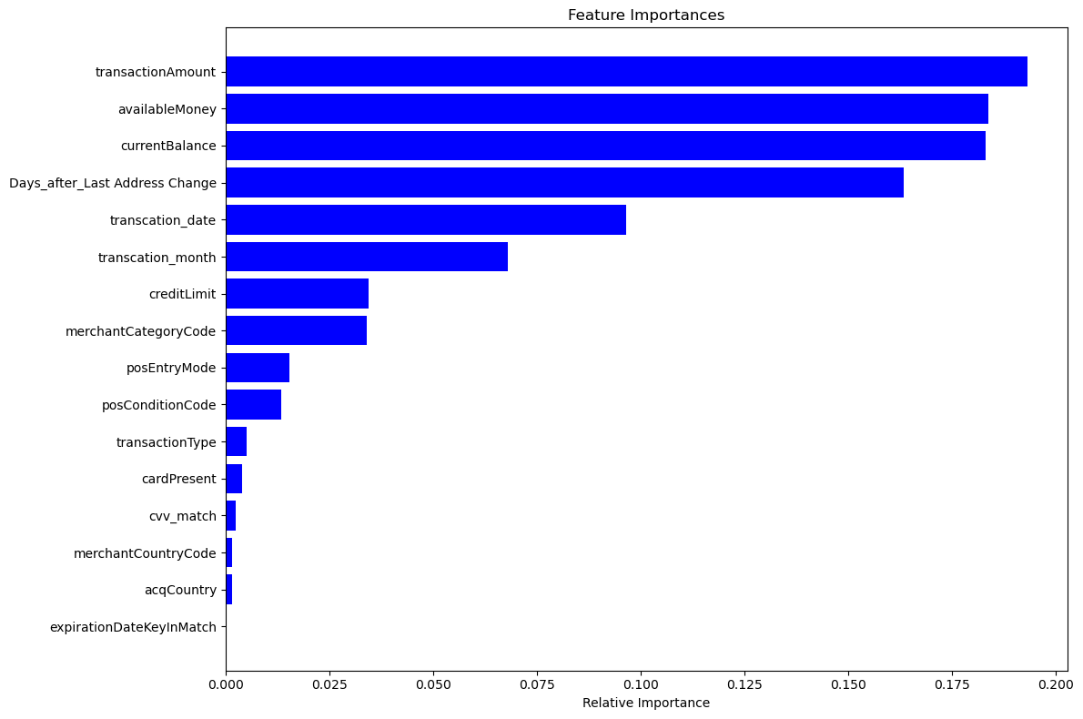
Missing Value Imputation The Most Common Method In the Field of Data Science (Imputation Using Mode: Highest Frequency Observed Values) Outlier Treatment: We have refrained from addressing any outliers in the dataset, given its financial nature. Feature Importance Using Random Forest Classification before Analysing

Slide 7
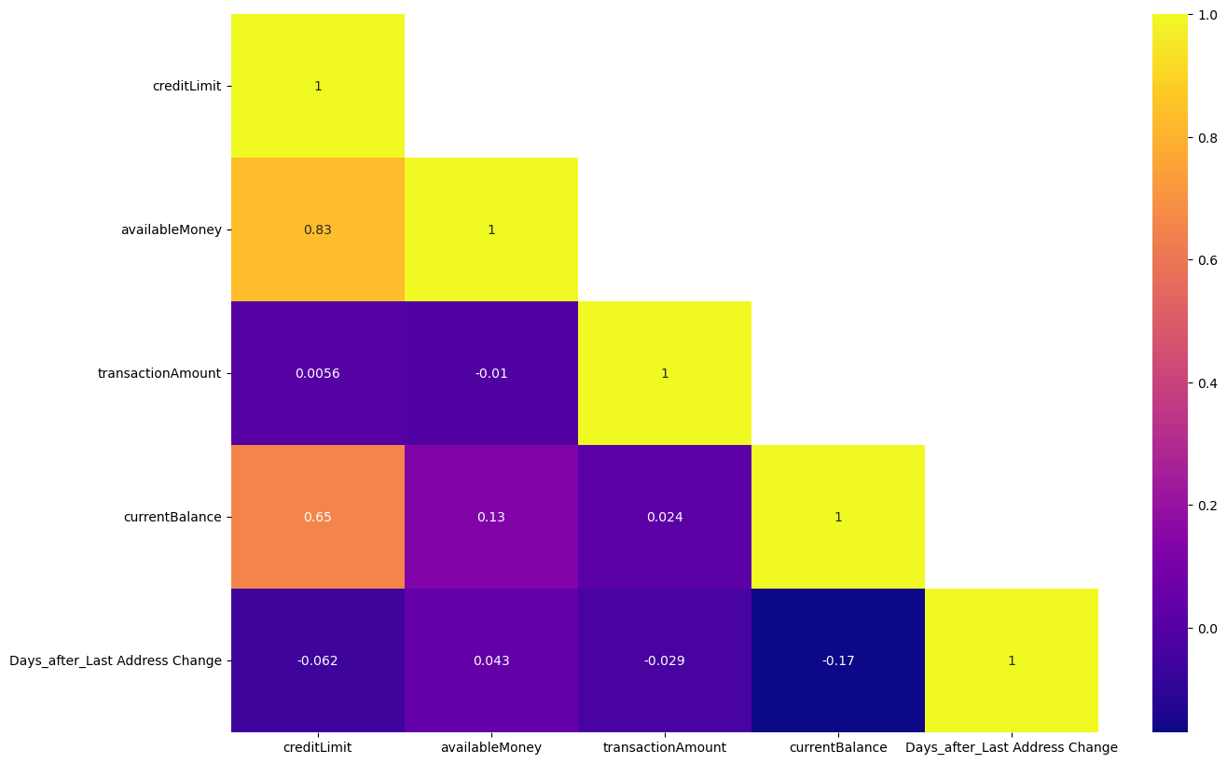
Exploratory Data Analysis
Univariate Numerical Analysis (Correlation Matrix of Heatmap)

Slide 8
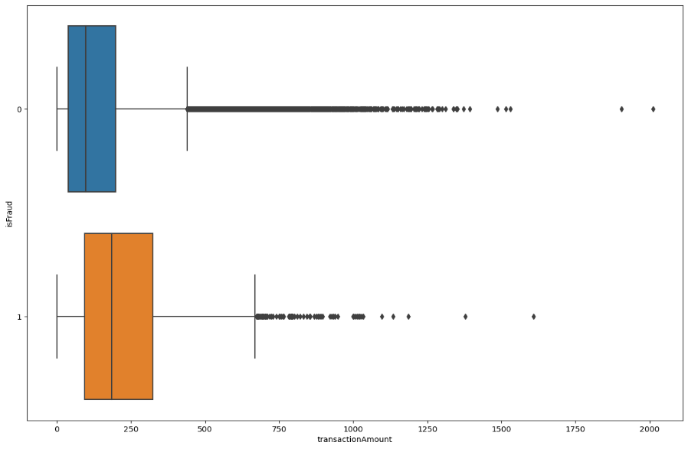
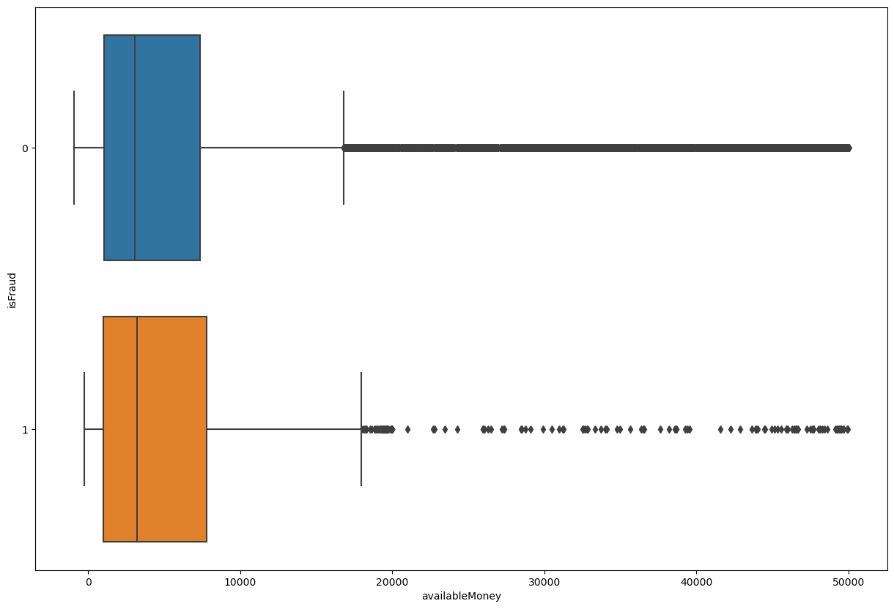
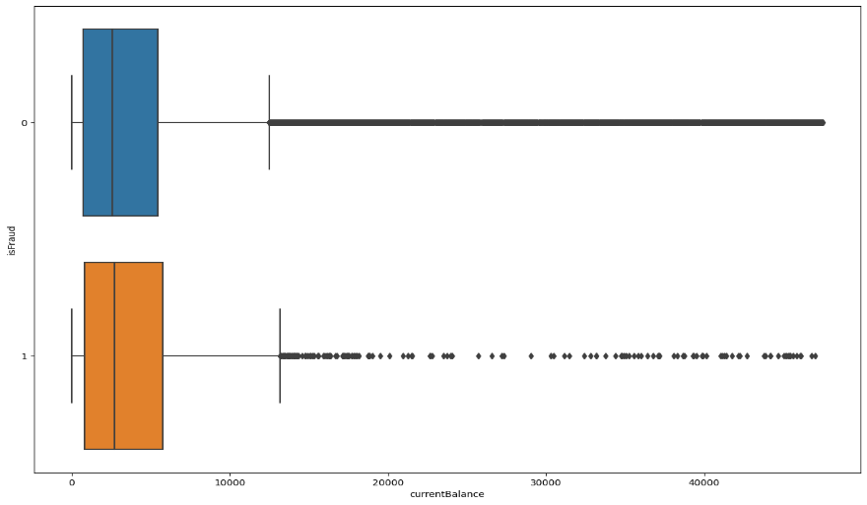
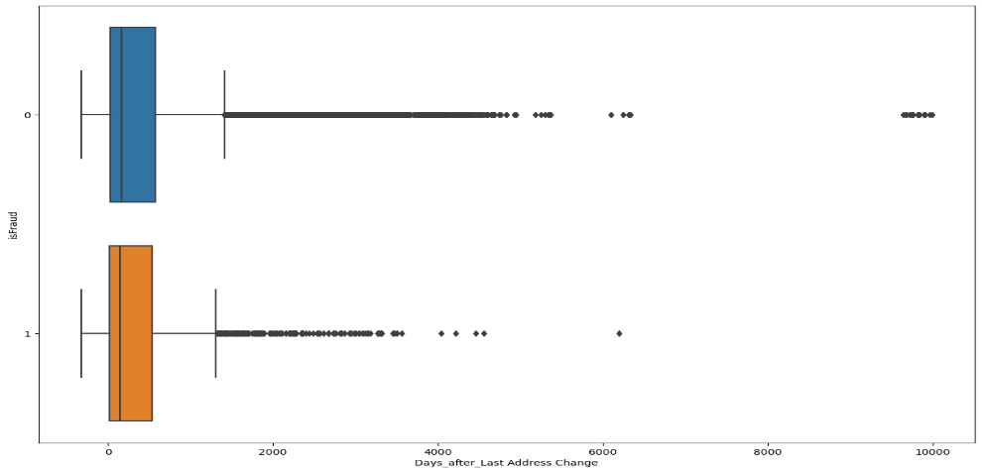
transactionAmount Vs isFraud
Bivariate Analysis:
availableMoney Vs isFraud
currentBalance Vs isFraud
Days_After_last_address_change Vs isFraud

Slide 9
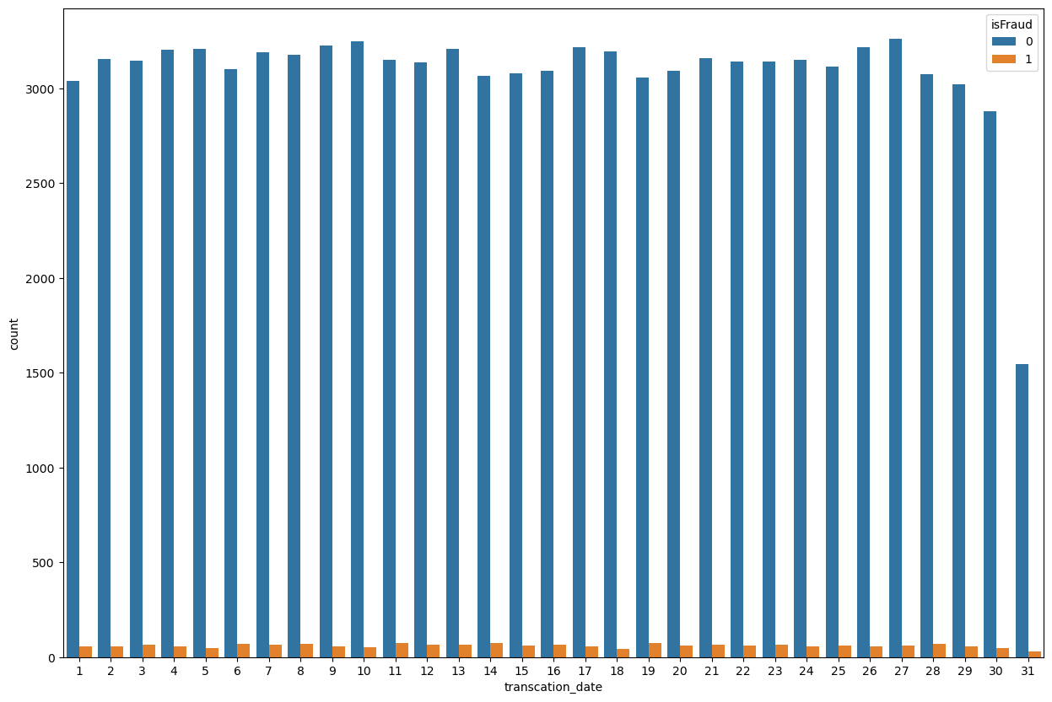
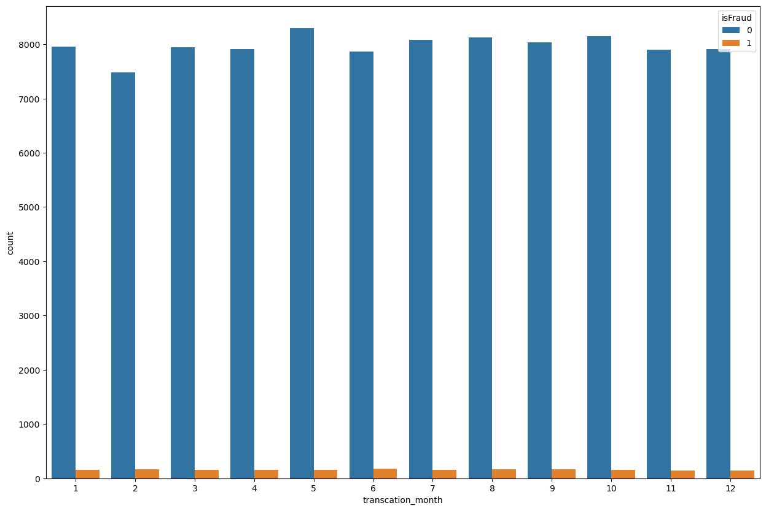
transaction_date Vs isFraud
transaction_month Vs isFraud

Slide 10
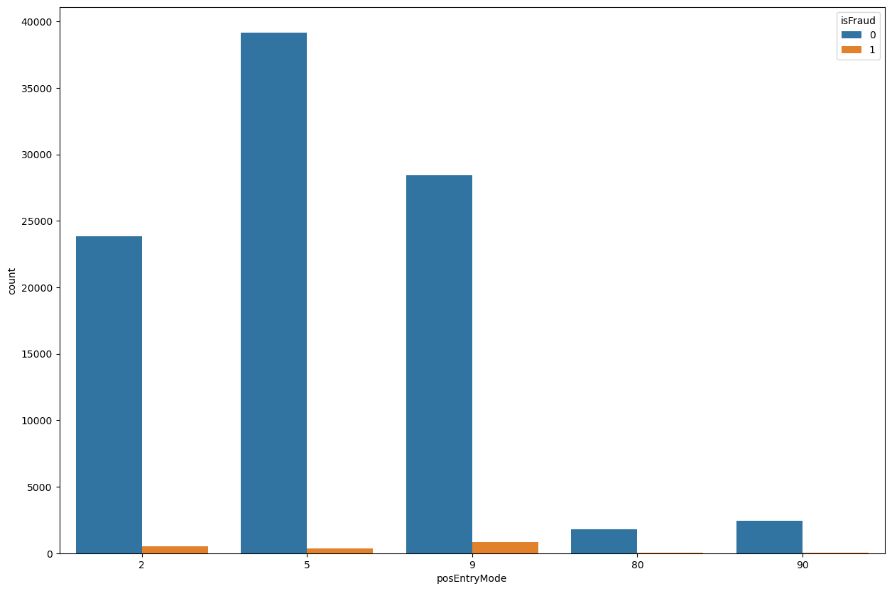
posEntryMode Vs isFraud

Slide 11
Model Building & Evaluation
The Modeling is the core of any machine learning project. This step is responsible for the results that should satisfy or help satisfied the project goals.
Building a model in machine learning is creating a mathematical representation by generalizing and learning from training data.
Our problem statement come under the Classification thus we have decided to use various models namely
Logistic Regression Model
Decision Tree Model
Random Forest Model
Naïve Bayes Model
Ada Boost Technique
XG Boost Technique
Evaluation: Recall, Precision, Accuracy & F1 Score

Slide 12
Stratified Sampling & SMOTE Techniques
Since our Data Set is Very Large classification data is an imbalanced data, it is desirable to sample the dataset into Sampling Datasets in a way that preserves the same proportions of examples in each class as observed in the Original Dataset. This is called a Stratified Sampling.
We can achieve this by setting the “Stratify” argument to the Merchant Category Code component of the original dataset. & we Have 97520 Rows after Sampling
Once the Sample is taken from various random state of 3 this Sample will be used for the various model with various combination, various ensemble and Stacking Techniques
Smote Has Been Done on Train Data Only and Test is Passed for Evaluation Metrics
Population Target Variable Proportion |  | Sample Target Variable Proportion
False | 98.42096 | False | 98.1009
True | 1.579042 | True | 1.899098
Value Counts of Train and Test
Target Variable Value Counts Train on SMOTE: 153048
Target Variable Value Counts Test: 19504

Slide 13
Base Model-Hyper Parameter Tuned

Slide 14
Final Model Performance:
Feature Importance for the best Model After Hyperparameters Tunned:
Model: Decision Tree Classifier Without SMOTE
Parameter Used:
GridSearchCV
Criterion | Entropy, Gini
Max Depth | 30, 35, 40
Min Samples Split | 50, 60, 70, 80, 90
Min Samples Leaf | 10, 20, 30, 40
Best Parameters
Criterion | Entropy
Max Depth | 30
Min Samples Split | 70
Min Samples Leaf | 10

Slide 15
Model Evaluation Chart Based Recall Measure
Model .No | Model | Recall measure for Without SMOTE model |  | Recall measure for With SMOTE model
 |  | Training dataset | Test dataset | Training dataset | Test dataset
1 | Decision Tree Classifier | 1 | 0.960316 | 1 | 1
2 | Random Forest Classifier | 0.980876 | 0.981542 | 0.947663 | 0.911916
3 | Bernoulli’s Naive Bayes | 0.980876 | 0.981542 | 0.659519 | 0.394586
4 | Ada Boost | 1 | 0.961393 | 1 | 0.925554
5 | XG Boost | 0.98217 | 0.98144 | 0.98217 | 0.98144
Recall measure for the models Before Hyperparameter tuning
Model .No | Model | Recall measure for Without SMOTE model |  | Recall measure for With SMOTE model
 |  | Training dataset | Test dataset | Training dataset | Test dataset
1 | DT Classifier Train Best Param | 0.980876 | 0.981542 | 0.947663 | 0.911916

Slide 16
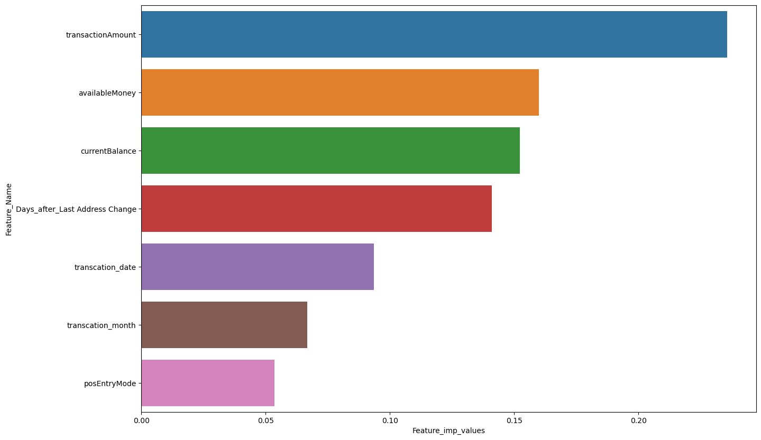
Top 7 important Features from best Model:

Slide 17
Business Interpretation:
Implement proactive measures for customer information updates and security enhancements.
Utilize dynamic credit limits based on transaction history.
Scrutinize larger transactions for fraud prevention.
Prioritize monitoring for accounts with low available funds.
Allocate extra resources for fraud prevention during seasonal peaks.
Implement real-time monitoring for transaction volume changes.
Emphasize security for accounts with higher available funds.
Adjust security measures with changes in transaction entry modes.
Tailor security to account for varying vulnerability levels.
Refine fraud detection strategies based on transaction characteristics.

Slide 18
References
https://www.kaggle.com/datasets/iabhishekbhardwaj/fraud-detection(Dataset)
https://www.fraud.com/post/the-history-and-evolution-of-fraud (Background Research)
https://www.amygb.ai/blog/how-fraud-detection-works-in-banking (Application)
https://www.sciencedirect.com/science/article/pii/S0957417421017164 (Past Reasearch)
https://ieeexplore.ieee.org/document/10085493 (Ongoing Research)

Slide 19
Thanks For Your Time
Please Share Your Feedback….!!
&
Any Question…?

